Slide 1

EPLQ: Efficient Privacy-
Preserving Location-Based
Query
This presentation reports on EPLQ, an efficient privacy-preserving
location-based query system. EPLQ enhances public safety and
location-based services (LBS) by focusing on secure spatial data
handling. It leverages advanced encryption protocols and spatial
indexing techniques to minimize privacy risks. This project addresses
critical challenges in protecting user location data while maintaining
efficient service delivery.

Slide 2

Project Overview: EPLQ
Project Title
Project Domain
Technology Stack
EPLQ: Efficient Privacy-Preserving
Location-Based Query for Encrypted
Data.
Public Safety and Location-Based
Services (LBS).
Frontend: HTML, CSS, JavaScript.
Backend: Firebase.
Encryption Protocols, Spatial
Indexing.

Slide 3
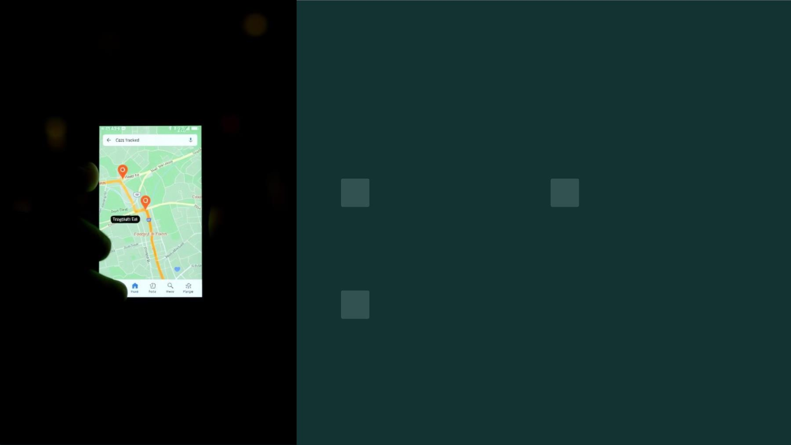
Motivation and Problem
Increased LBS
Adoption
Privacy Risks
LBS exposes user locations,
raising privacy concerns.
Smartphones have boosted
location-based services.
Lack of Protection
Existing systems lack comprehensive privacy measures.

Slide 4

Research Objectives and
Innovations
Privacy
Develop privacy-preserving spatial range queries.
Encryption
Create efficient location-based query encryption.
Minimize Risks
Reduce location data exposure risks.

Slide 5

Technical Architecture: Encryption
Circular Area Identification
2
Identifies locations within a specific
circular area.
Predicate-Only Encryption
Novel approach to encrypt location
data.
1
Data Protection
3
Protects user location from
unauthorized access.

Slide 6

Privacy-Preserving Tree Index
Improve Query Latency
1
Efficient Spatial Retrieval
2
Minimize Overhead
3

Slide 7
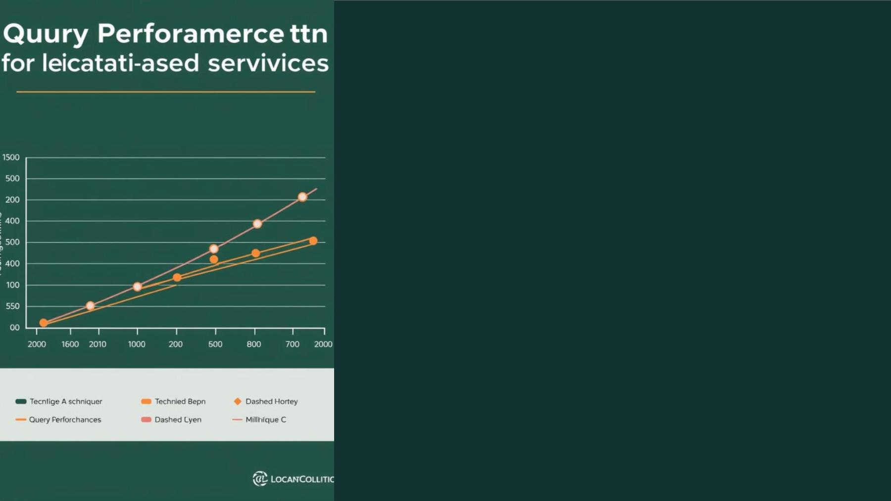
Performance Characteristics
0.9s
Query Generation
Time on mobile device.
Seconds
POI Search
Time on workstation/cloud.

Slide 8

Security Analysis and Qualities
Predicate-Only
1
Encryption prevents exposure.
Unauthorized Access
2
Protects spatial data.
3
Encrypted Queries

Slide 9
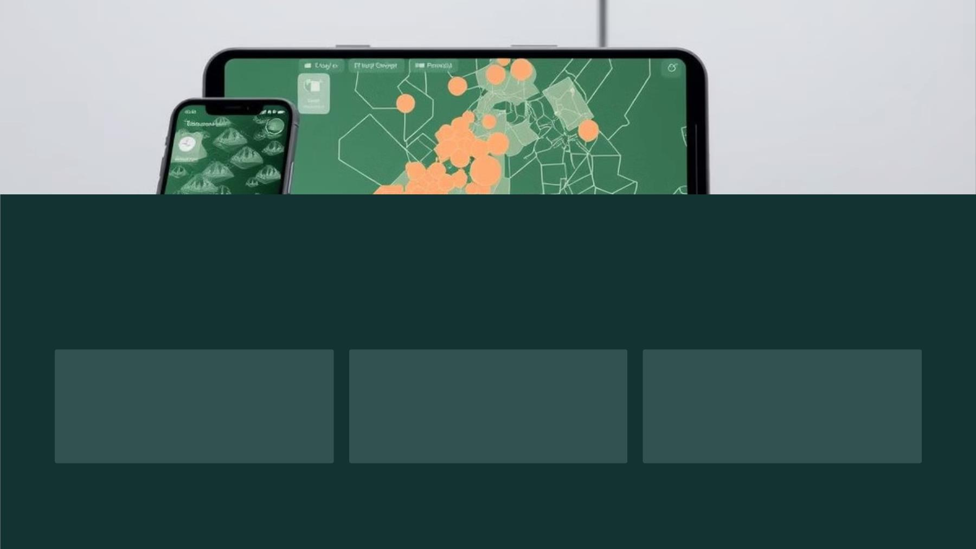
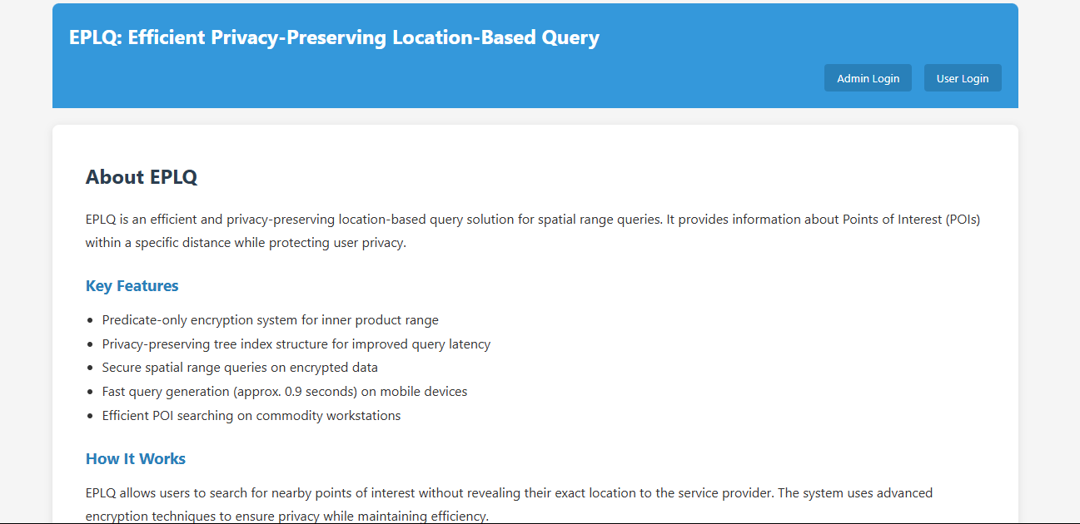
Experimental Validation and Findings
Effectiveness
Successful Implementation
Minimal Overhead
Demonstrated in privacy-
preserving spatial queries.
Of encrypted location-based
services.
Performance impact is minimal.

Slide 10

Conclusion and Future Work
EPLQ significantly advances privacy-preserving location queries. It
offers a solution to protect user location data. It maintains service
efficiency. Future work includes extending encryption techniques.
Further work includes investigating performance optimizations. It can
explore cross-platform implementation strategies.

